Slide 1
DIJKSTRA'S ALGORITHM

Slide 2

SINGLE-SOURCE SHORTEST PATH PROBLEM
Single-Source Shortest Path Problem - The problem of finding shortest paths from a source vertex v to all other vertices in the graph.

Slide 3
DIJKSTRA'S ALGORITHM
Dijkstra's algorithm - is a solution to the single-source shortest path problem in graph theory.
Works on both directed and undirected graphs. However, all edges must have nonnegative weights.
Approach: Greedy
Input: Weighted graph G={E,V} and source vertex v∈V, such that all edge weights are nonnegative
Output: Lengths of shortest paths (or the shortest paths themselves) from a given source vertex v∈V to all other vertices

Slide 4
DIJKSTRA'S ALGORITHM - PSEUDOCODE
dist[s] ←0 (distance to source vertex is zero)
for all v ∈ V–{s}
do dist[v] ←∞ (set all other distances to infinity)
S←∅ (S, the set of visited vertices is initially empty)
Q←V (Q, the queue initially contains all vertices)
while Q ≠∅ (while the queue is not empty)
do u ← mindistance(Q,dist) (select the element of Q with the min. distance)
S←S∪{u} (add u to list of visited vertices)
for all v ∈ neighbors[u]
do if dist[v] > dist[u] + w(u, v) (if new shortest path found)
then d[v] ←d[u] + w(u, v) (set new value of shortest path)
(if desired, add traceback code)
return dist

Slide 5
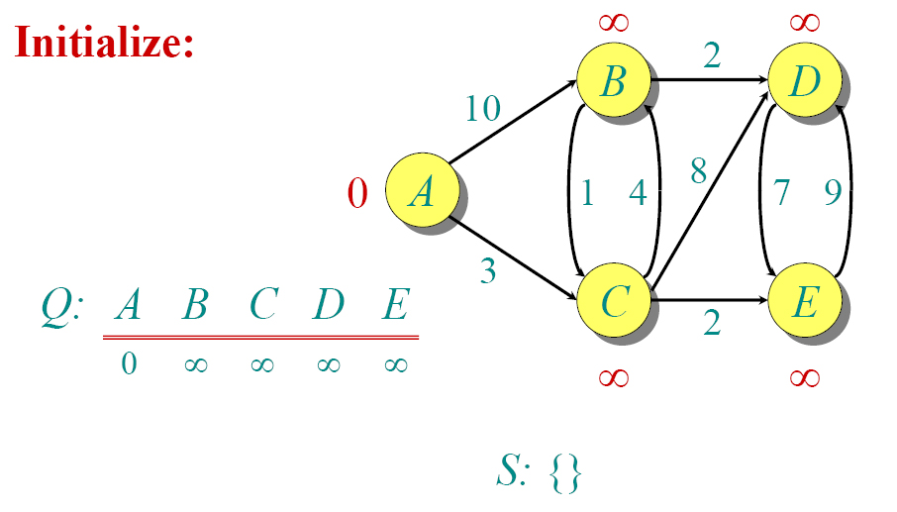
DIJKSTRA ANIMATED EXAMPLE

Slide 6

DIJKSTRA ANIMATED EXAMPLE

Slide 7

DIJKSTRA ANIMATED EXAMPLE

Slide 8

DIJKSTRA ANIMATED EXAMPLE

Slide 9

DIJKSTRA ANIMATED EXAMPLE

Slide 10

DIJKSTRA ANIMATED EXAMPLE

Slide 11

DIJKSTRA ANIMATED EXAMPLE

Slide 12

DIJKSTRA ANIMATED EXAMPLE

Slide 13

DIJKSTRA ANIMATED EXAMPLE

Slide 14

DIJKSTRA ANIMATED EXAMPLE

Slide 15
IMPLEMENTATIONS AND RUNNING TIMES
The simplest implementation is to store vertices in an array or linked list. This will produce a running time of
O(|V|^2 + |E|)
For sparse graphs, or graphs with very few edges and many nodes, it can be implemented more efficiently storing the graph in an adjacency list using a binary heap or priority queue. This will produce a running time of
O((|E|+|V|) log |V|)

Slide 16
DIJKSTRA'S ALGORITHM - WHY USE IT?
As mentioned, Dijkstra’s algorithm calculates the shortest path to every vertex.
However, it is about as computationally expensive to calculate the shortest path from vertex u to every vertex using Dijkstra’s as it is to calculate the shortest path to some particular vertex v.
Therefore, anytime we want to know the optimal path to some other vertex from a determined origin, we can use Dijkstra’s algorithm.

Slide 17


APPLICATIONS OF DIJKSTRA'S ALGORITHM
- Traffic Information Systems are most prominent use
- Mapping (Map Quest, Google Maps)
- Routing Systems

Slide 18
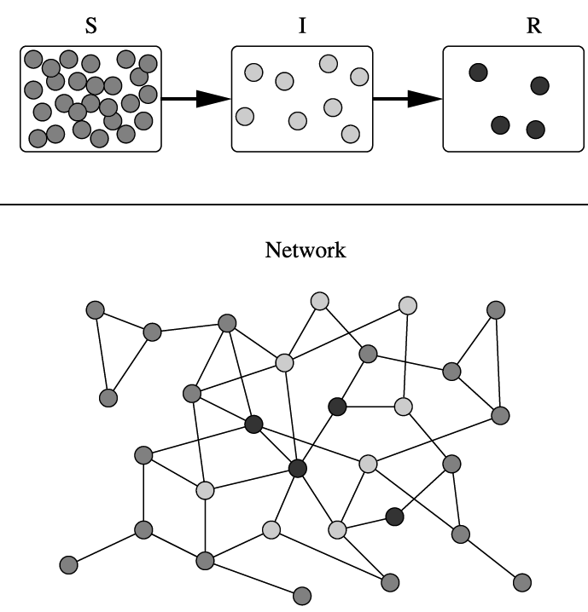
APPLICATIONS OF DIJKSTRA'S ALGORITHM
One particularly relevant this week: epidemiology
Prof. Lauren Meyers (Biology Dept.) uses networks to model the spread of infectious diseases and design prevention and response strategies.
Vertices represent individuals, and edges their possible contacts. It is useful to calculate how a particular individual is connected to others.
Knowing the shortest path lengths to other individuals can be a relevant indicator of the potential of a particular individual to infect others.

Slide 19
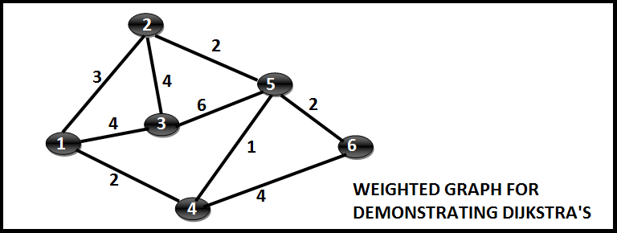
PRACTICE

